Slide 1
BUILDING VOCABULARY SKILLS
UNIT 1, Chapter 2
Get a vocabulary GO from the table and fill in your vocabulary terms in alphabetical order.
PART OF SPEECH COLOR CHART
WORD BANK
NOUN
(n.)
VERB
(v.)
dialog
erratic
extensive
forfeit
fortify
illuminate
isolate
refuge
reminisce
urban
ADVERB
(adv.)
ADJECTIVE
(adj.)

Slide 2
VOCABUALRY TERM
dialog
Part of Speech
Definition
Derivatives

Slide 3
VOCABUALRY TERM
erratic
Part of Speech
Definition
Derivatives

Slide 4
VOCABUALRY TERM
extensive
Part of Speech
Definition
Derivatives

Slide 5
VOCABUALRY TERM
forfeit
Part of Speech
Definition
Derivatives

Slide 6
VOCABUALRY TERM
fortify
Part of Speech
Definition
Derivatives

Slide 7
VOCABUALRY TERM
illuminate
Part of Speech
Definition
Derivatives

Slide 8
VOCABUALRY TERM
isolate
Part of Speech
Definition
Derivatives

Slide 9
VOCABUALRY TERM
refuge
Part of Speech
Definition
Derivatives

Slide 10
VOCABUALRY TERM
reminisce
Part of Speech
Definition
Derivatives

Slide 11
VOCABUALRY TERM
urban
Part of Speech
Definition
Derivatives

Slide 12
Building Vocabulary Skills: Unit 1, Chapter 1
NOUN
(n.)
VOCABULARY TERM | PART OF SP. | DEFINITION
acknowledge | (v.) | to admit
alternative | (n.) | a choice
anecdote | (n.) | a short, interesting story
appropriate | (adj.) | suitable, proper
avert | (v.) | to prevent, to ward off
candid | (adj.) | Honest, frank or outspoken
compel | (v.) | to force
comply | (v.) | to do as asked
concise | (adj.) | clear and brief
drastic | (adj.) | extreme
VERB
(v.)
ADVERB
(adv.)
ADJECTIVE
(adj.)

Slide 13
Building Vocabulary Skills: Unit 1, Chapter 2
NOUN
(n.)
VOCABULARY TERM | PART OF SP. | DEFINITION
dialog | (n.) | A conversation between two or more people as a feature of a book, play, or movie
erratic | (adj.) | Not even or regular in pattern or movement; unpredictable
extensive | (adj.) | Covering or affecting a large area
forfeit | (v.) | To lose or be deprived of something as a penalty of wrongdoing
fortify | (v.) | To protect or strengthen against attack; surround or provide with defense
illuminate | (v.) | To supply or brighten with light; to light up; to make clear
isolate | (v.) | To set or place apart; detach or separate so as to be alone
refuge | (n.) | Shelter or protection from danger
reminisce | (v.) | To recall past experiences or events
urban | (adj.) | Relating to a designated area of a city or town, characteristic of or accustomed to city culture
VERB
(v.)
ADVERB
(adv.)
ADJECTIVE
(adj.)

Slide 14
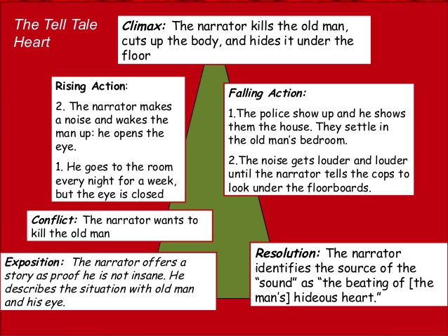
CLIMAX
By: Edgar Allan Poe
RISING ACTION
FALLING ACTION
RESOLUTION

Slide 15
CLIMAX
By: Edgar Allan Poe
FALLING ACTION
RESOLUTION

Slide 16
By: Edgar Allan Poe
FALLING ACTION
RESOLUTION

Slide 17
By: Edgar Allan Poe
RESOLUTION

Slide 18
By: Edgar Allan Poe

Slide 19
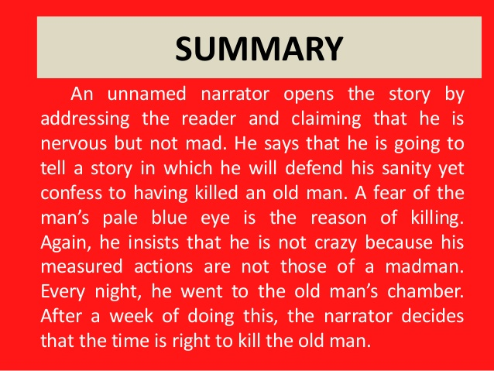
The Tell-Tale Heart”, by Edgar Allan Poe
E) The narrator opens the story by declaring his is not mad. The old man he lives with has an eye like a vulture. He loves the old man, but the vulture eye haunts him. RA) He spends seven nights silently spying on the old man in his sleep. On the eighth night, he makes a noise that wakes the old man, exposing the vulture eye. C) The narrator, upon seeing the eye, kills the old man, cuts up his body, and buries him under the floor boards of the house. FA) The police show up at the home, and the narrator invites them to inspect the home and the old man’s belongings. While conversing with the police officers, the narrator becomes more agitated at a noise he hears and confesses the crime to them. R) The narrator exposes the space beneath the floorboards, revealing the old man’s body, and admits the noise he hears is the beating of the old man’s “hideous heart”.

